Slide 1
RQF Assessor Training Course
leading to the
Level 3 Certificate in Assessing Vocational Achievement
CAVA
presented by
Rob, Simon & Lucy Faulkner
Notes:
Intro slide only.
Introduce self briefly then move onto domestics.
Come back to this slide again after

Slide 2
Domestics before we start….
Emergencies
Fire alarm, exits, Assembly Point
Toilets
Smoking
Refreshments / Lunch
Mobile phones next slide >>>>

Slide 3
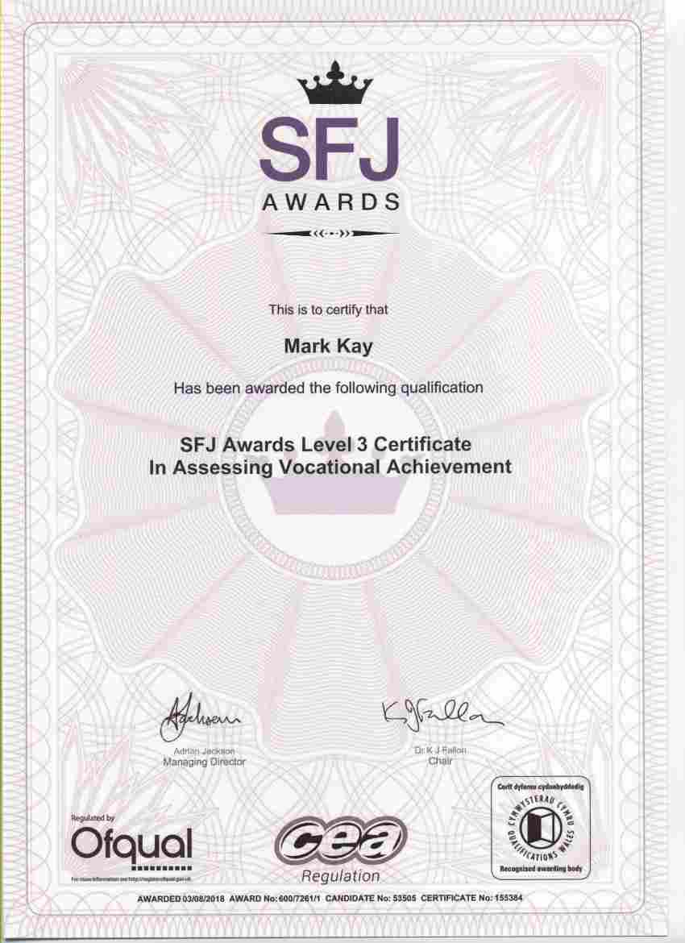
RQF Assessor Certificate
Your name here
A1 Assessment Centre Number
139

Slide 4

The Big Three TAQA
TRAINER
Assessor CAVA
Internal Quality Assurer
(Internal Verifier)

Slide 5
To be an Assessor...
Vocational Experience & knowledge in the job
The Assessor Qualification
An approved Centre to work though
next slide >>>>
Notes:
3 things required to be an assessor: you need to have ‘occupational expertise’
Emphasise only one assessor qualification - allows you to assess anything that you have vocational experience in.
Cannot work independently.... Can be self-employed but your candidates must be registered through an approved centre.
I am here to help you achieve no. 2. no.1 & no.3 are up to you.

Slide 6
A1 Assessment formed in 2008 but Rob has been running a centre since 1986 ‘Proper’ family business with 3 generations on parade. Around 4000 assessors trained… …so far
Who are we?
next slide >>>>

Slide 7
Our Team

Slide 8

Rob Faulkner
Born 1937 – Flew Sea Venoms in the Fleet Air Arm off HMS Victorious Has been involved in Training and Assessing since around 1973
next slide >>>>

Slide 9
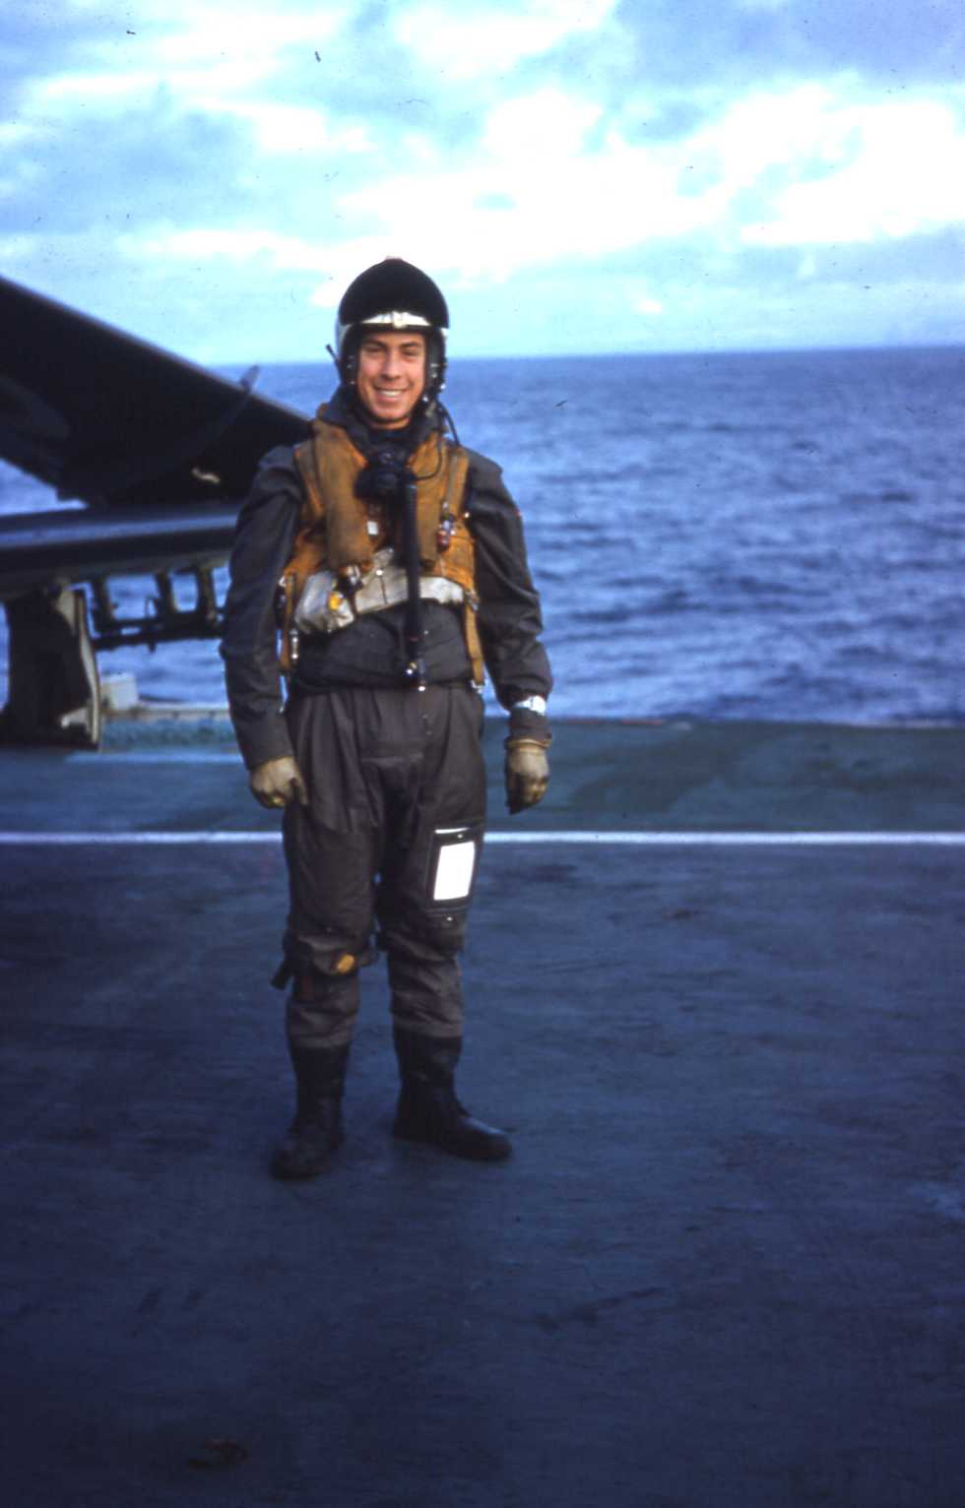

Rob Faulkner
HMS Victorious
next slide >>>>

Slide 10

Simon Faulkner
Born 1966 – Flew Phantoms in the Royal Air Force then The Queens Flight ‘til 1998 Writes databases for anyone who needs them.
next slide >>>>

Slide 11
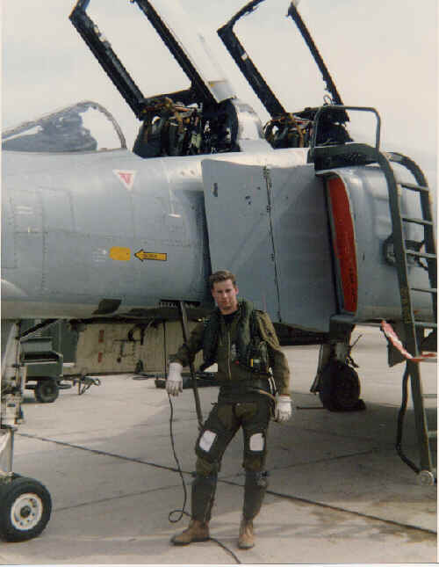

Simon Faulkner
32 (TR) Sqn RAF Northolt
next slide >>>>

Slide 12
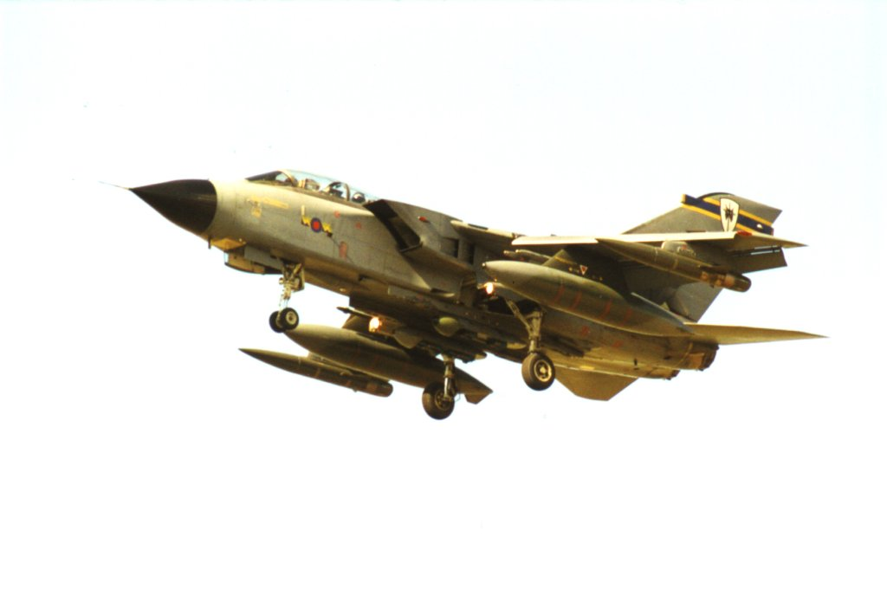

Mike Faulkner
Born 1970 – Flew Tornados in the Royal Air Force and now is a Captain on A340s for Virgin.
Holiday time…
next slide >>>>

Slide 13
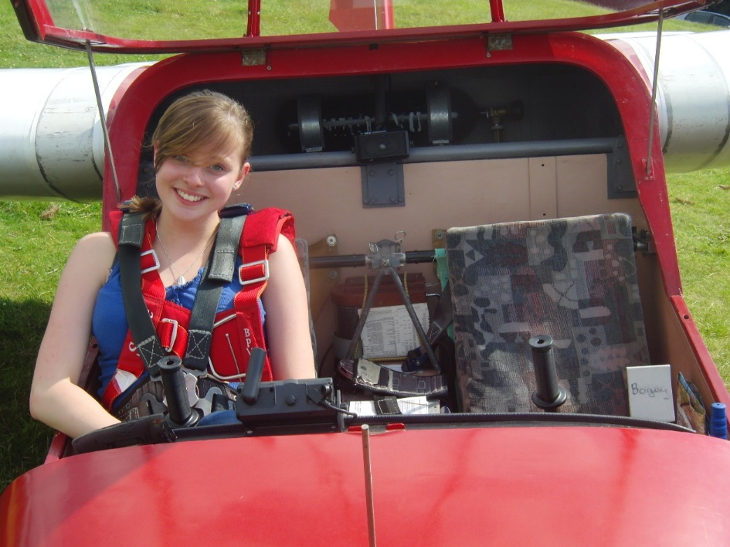

Lucy Faulkner
Falconry
Born 1995 – Enjoys gliding and falconry.
Steppe Eagle
next slide >>>>

Slide 14
Who are you? What’s your background?
Career
Job now
Training experience
Assessing experience
Do you have an NVQ?
What will you be assessing?
next slide >>>>

Slide 15

“What do I have to do to achieve my Assessor Certificate ?”
Evidence Requirements
4 complete Assessments
1 observed by A1A
another with the same Candidate
2 more with another Candidate
( NB TWO Candidates, TWICE each )
then.......
Complete your portfolio
Professional Discussion
Knowledge & Understanding
Any Additional Evidence
minimum
Completed this afternoon
next slide >>>>
Notes:
More details later but just to give you an idea......

Slide 16
Aims & Objectives
Aim:
Give you the knowledge & skills you need to be an assessor
Objectives:
Plan & Conduct an Assessment
Complete own Portfolio of Evidence
next slide >>>>

Slide 17
The Assessment and Training Cycle
Initial Assessment & Diagnostic Testing
Decide what you want them to be able to do
Design Training
Organise and Deliver Training
Assess Learners
Evaluate Training & Identify Shortfalls
Identify Aims & Objectives and
How to Assess them
Summative Assessment
To Check Results
Formative assessment
To Check progress
next slide >>>>

Slide 18
Some Recent History!
NVQ 1986-2010
QCF Qualification and Credit Framework
Was abandoned 31st Sept 2015
RQF Regulated Qualification Framework
(which is exactly the same but spelt differently)
next slide >>>>
Notes:
One of the most significant changes to the QCF is the inclusion of a framework to teach (not just assess)
Accommodates apprenticeships and funding requirements

Slide 19
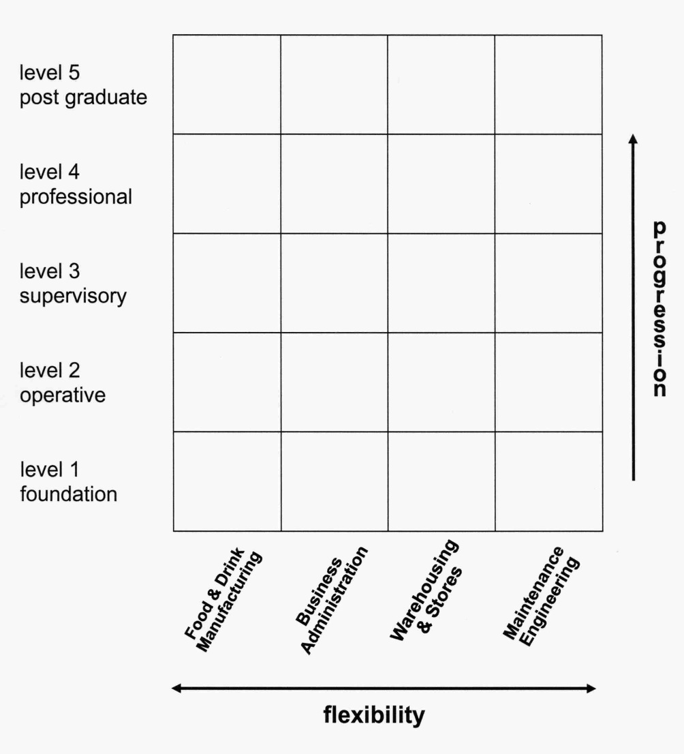
NVQ Framework ( the pigeon hole model )
Flashback to NVQs
(National Vocational Qualifications)
NCVQ > QCA > QCDA > OfQual
Lead Bodies
Awarding Bodies
next slide >>>>

Slide 20
RQF Framework
8
7
6
5
4 |  | eg IQA Certificate | eg Diploma in A&G
3 | eg RQF Assessor Award | eg RQF Assessor Certificate
2
1
Entry
Level | AWARD 1 – 12 credits | CERTIFICATE 13 – 36 credits | DIPLOMA 37 or more credits
next slide >>>>
Notes:
Concept is, that whatever your vocation, at whatever level you work ,there should be a QCF qualification to suit you.
The credits you gain can be used towards other qualifications provided they meet the:
- Rules of combination

Slide 21
RQF Levels
RQF Level | Equivalent to...
8 | PHD / Fellowship
7 | Masters Degree / Membership
6 | Degree / Associateship
5 | NVQ 5 / HNC / HND / Foundation Degree
4 | NVQ 4 / Higher Professional Diploma
3 | NVQ 3 / A Level / BTEC National Cert’/Dip’
2 | NVQ 2 / GCSE A-C / BTEC First Certificate
1 | NVQ 1 / GCSE Grade D-G
next slide >>>>

Slide 22
RQF Levels
LEVELS
As defined in “Regulatory Arrangements for the QCF” ( now defunct! )
Level 2
well defined, routine tasks
exercise autonomy and judgement subject to overall direction and guidance
Level 3
complex and non-routine tasks
responsibility for supervising and guiding others
- exercise autonomy and judgement within limited parameters
next slide >>>>
Notes:
Get the definition for level 6
_ HANDOUTS of pages from Regulatory Arrangements for QCF

Slide 23
Structure of a Vocational Qualification
Units
Level - not always the same as qualification level
Credit value - amount of work (1 credit = nominal 10 guided learning hours)
Guided or notional learning hours - for the ‘teaching bit’
Learning Outcomes
- stated in the form “the Learner will be able to…”
- a statement of what a learner can be expected to know, understand, or do as a result of a process of learning
Assessment Criteria
- stated in the form “the Learner can…”
- these are what the NOS expect the learner can do to demonstrate competence
Assessment Methods and Evidence Requirements
- give more or less specific instructions to Assessors
Knowledge & Understanding
- sometimes covered in a separate Unit
- often written as “State / Explain / Describe”
- may also be “inferred through performance”
next slide >>>>
Notes:
Quick whizz through definitions, more detail later

Slide 24
Rules of Combination
This is how qualifications are ‘made up’
Combination of Units:
mandatory and optional
All units will be relevant to the qualification
>/= 50% of units must be at level of the qualification
next slide >>>>

Slide 25
RQF Assessor Qualification
..... The units
Unit 1: Understanding the Principles and Practices of Assessment - 3 Credits
Unit 2: Assess Occupational Competence in the Work Place - 6 Credits
Unit 3: Assess Vocational Skills, Knowledge & Understanding - 6 Credits
next slide >>>>
Notes:
So now you understand the make up of a QCF qualification, this is how the QCF ASSESSOR Qualification is made up....

Slide 26
Who’s Who?
England
The Office of Qualifications and Examinations Regulation
Regulatory Authorities
OfQual, DCELLS, CCEA
Sector Skills Council (SSC)
Awarding Body (EQA)
Approved Centre
Centre Co-ordinator
Internal Quality Assurance team
Assessor team
Wales
The Department for Children, Education, Lifelong Learning and Skills
Northern Ireland
The Council for the Curriculum, Examinations & Assessment
next slide >>>>

Slide 27
RQF Who’s Who
OfQual - non ministerial government department (was QCA)
Sector Skills Councils - state sponsored, employer-led - create the National Occupational Standards (NOS) - currently 25 - Cskills for construction - CfA for Business’ Admin’ ?
Awarding Bodies - City & Guilds, EDI, EdExcel, OCR - Private company or charity that compete for ‘business’ of...
Approved Centres - Organisation accredited to deliver specific qualifications - Private companies or charities or colleges.
next slide >>>>

Slide 28
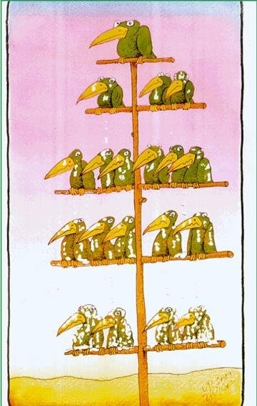
Awarding Body
EQA
IQA
Assessors
Candidates

Slide 29
TEST
1. close all books, notes, etc.
2. write your Name, Organisation, and date
on the Answer Sheet
SIX questions
10 minutes
20 marks
passmark = 15

Slide 30
4 Stages of an Assessment
Setting the scene
Long term
- overview of RQF programme
Short term
- plan the next observation or Unit in detail
On the day
- set candidate at ease, "just run through what you are going to do…."
2. Collecting the evidence
(a) Observation
(b) Questioning and Professional Discussion
(c) Examining products
3. Making your decision
(a) yes
(b) not yet
4. Giving feedback
2 good points,
"I particularly liked…."
(b) 2 (max.) weak points,
"I was concerned about…."
(c) the way ahead,
"this is what we will do next….“
next slide >>>>

Slide 31
4 Stages of an Assessment
Plan the Assessment
Collect the Evidence
Decide & Record
Feedback
next slide >>>>

Slide 32
Assessment Planning
1. KEY FACTORS:
- is candidate ready?
~ list of bullet points to be observed
~ list of questions to be asked
- suitable time & place, equipment, real work
2. HOLISTIC APPROACH - cover as much as possible during your visit - consider evidence required for several Units at the same time…. often part of the same job - use a variety of assessment methods
3. RISK ASSESSMENT - for your attendance at the site
next slide>>>>
next slide >>>>
Notes:
Risk: PPE, site induction, cscs card, etc

Slide 33
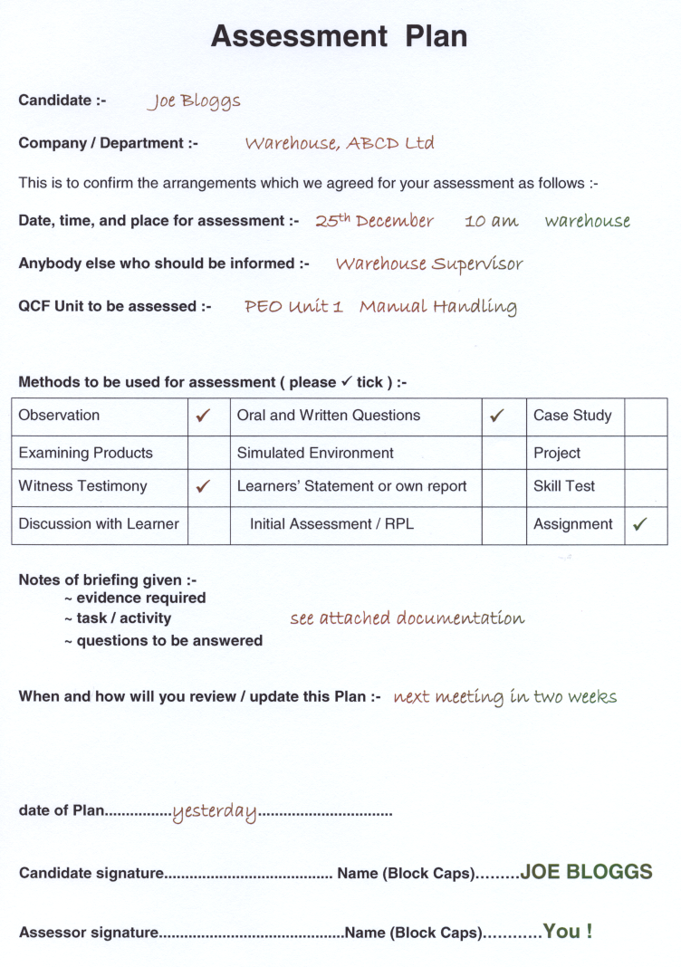
example
next slide >>>>

Slide 34
Involving Learners & Others
Motivation of learner
success rate up
your workload down!
Witness Testimonies
improved authenticity & good source of evidence
proves competency over longer period
next slide >>>>
Notes:
Not much to say here but it is part of the syllabus so I am obliged to spend a minute on the subject!
Already alluded to the benefit of getting the learner on side at induction and during planning
Makes the whole experience more enjoyable and the candidate is more likely to succeed.
Involving others, eg witnesses, makes it easier for you and also, makes it harder for candidates to blag their way through. ie you could find out that some of the evidence provided by the candidate was nothing to do with him
K&U Question 5

Slide 35
4 Stages of an Assessment
Plan the Assessment
Collect the Evidence
Decide & Record
Feedback
Collecting the Evidence
next slide >>>>

Slide 36
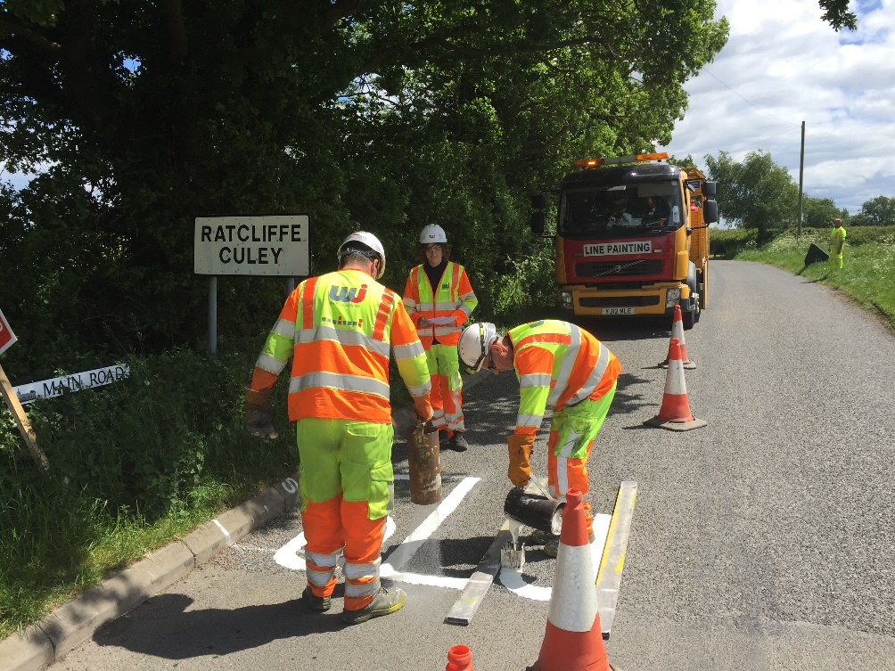
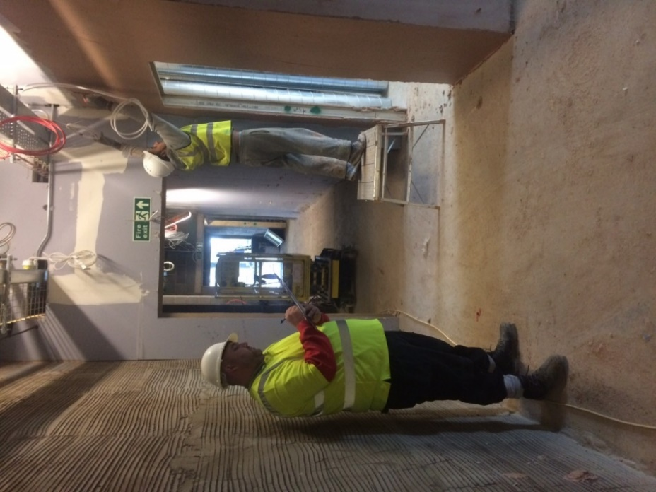
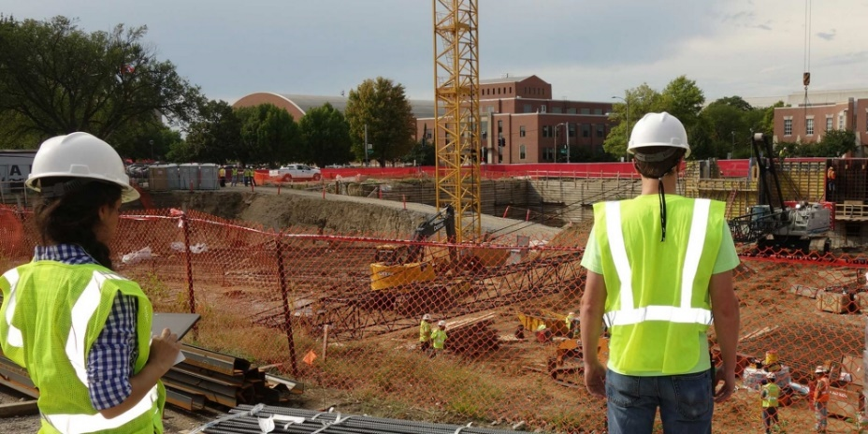
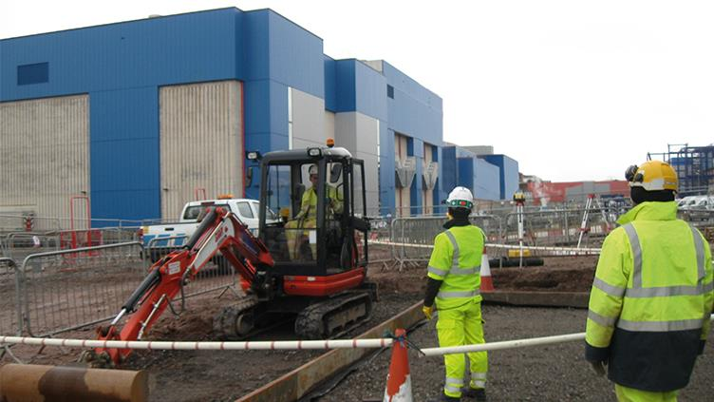
Observation
next slide >>>>
Notes:
Elicit pro’s & con’s
Ask which of these methods they could see themselves using for Manager qual?

Slide 37
Observation
Strengths:
- very authentic, hard to fake - candidate still working (no disruption) - proves skill in workplace
Weaknesses:
- takes up assessor time - only see what they are doing: can’t dictate…
Considerations:
- candidate at ease with assessor presence - don’t help or hinder - remain unobtrusive but not unfriendly - video & commentary? - good observation report with ac mapped - give feedback
next slide >>>>
Notes:
Elicit pro’s & con’s
Ask which of these methods they could see themselves using for Manager qual?

Slide 38

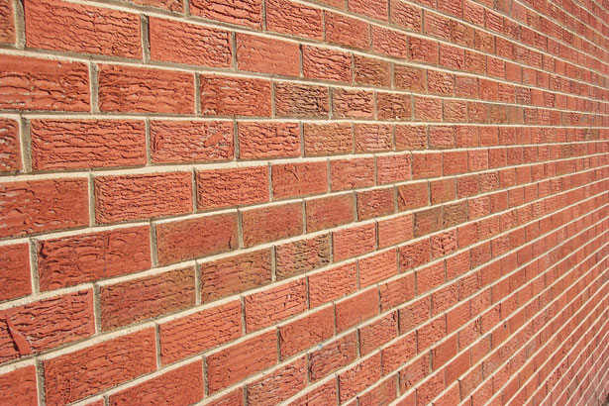
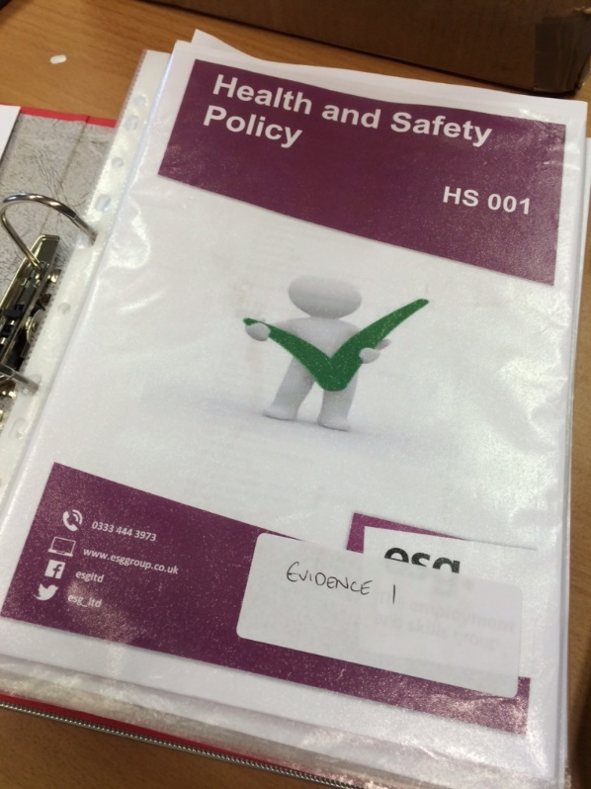
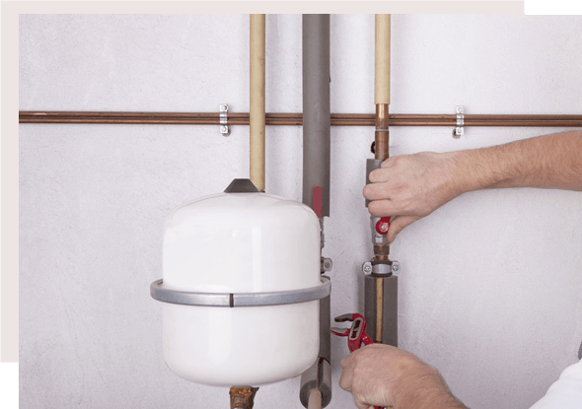
Product - something the candidate has produced
next slide >>>>
Notes:
Elicit pro’s & con’s
Ask which of these methods they could see themselves using for Manager qual?

Slide 39
Product
Strengths:
- helps support or fill the gaps from observation - an easy source of evidence
Weaknesses:
- might not be candidates work - needs more information
Considerations:
- discuss with the candidate - explain the relevance - use a witness to authenticate - don’t need whole document
next slide >>>>
Notes:
Elicit pro’s & con’s
Ask which of these methods they could see themselves using for Manager qual?

Slide 40

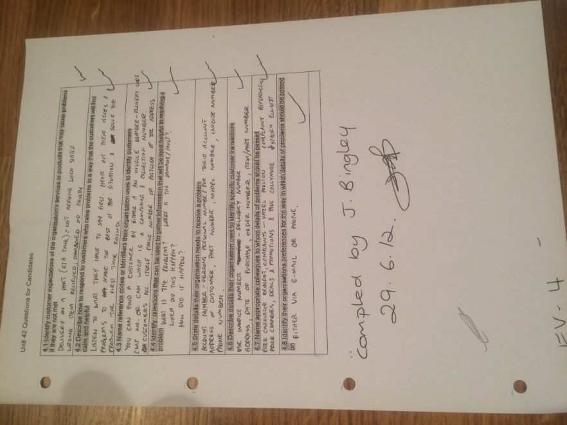
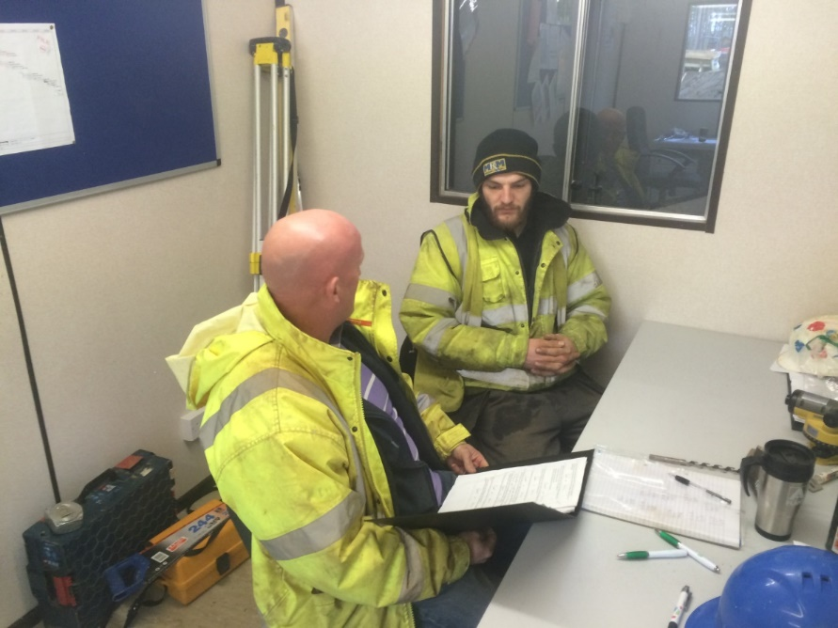
Questions
next slide >>>>

Slide 41
Written Questions
Strengths:
- easy & quick for assessors - allows candidate to work in their own time - produces written evidence for portfolio
Weaknesses:
- candidates don’t like writing: homework feel - takes them time - candidates can cheat - don’t understand questions
Considerations:
- ensure candidates well briefed - offer support - check answers with them - give feedback
next slide >>>>
Notes:
Elicit pro’s & con’s
Ask which of these methods they could see themselves using for Manager qual?

Slide 42
Oral Questions (Professional Discussion)
Strengths:
- candidates prefer talking to writing - very authentic: candidates knowledge - can reword, expand, relate questions - can combine with observation & product
Weaknesses:
- can put candidates under pressure - takes a long time - answers must be recorded for portfolio evidence - assessors asking leading questions
Considerations:
- put candidate at ease - conduct after observation & relate to workplace - give feedback to encourage participation - use Dictaphone and time map
next slide >>>>
Notes:
Elicit pro’s & con’s
Ask which of these methods they could see themselves using for Manager qual?

Slide 43
Different Tests
Competence Based Assessment
Initial Assessment
Training Needs Identification
Diagnostic Testing
Basic Numeracy, Literacy, ICT
Functional Skills Assessment
Formative Progress Assessment
Summative End or Achievement Testing
Aptitude Testing
Attitude Testing
Intelligence Testing
next slide >>>>

Slide 44
Assessment and Testing
CRITERION REFERENCED
“Mastery”
Pass Mark
so everybody could “pass” ~ or fail !
NORM REFERENCED
Competitive
Depends on other people taking same test
could come top even if not very good
because everybody else was worse!
next slide >>>>

Slide 45
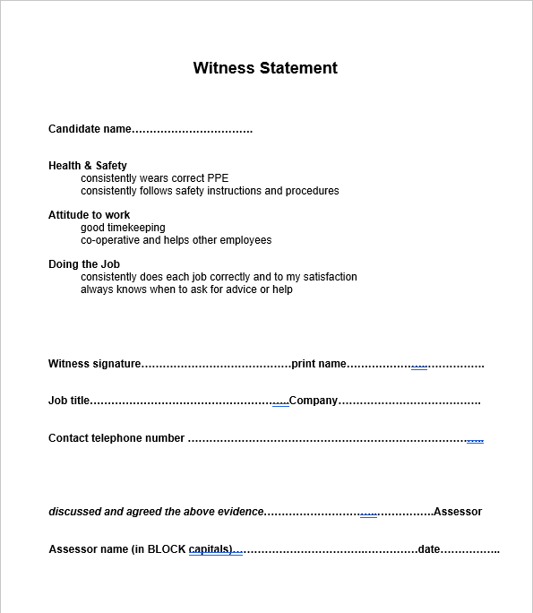
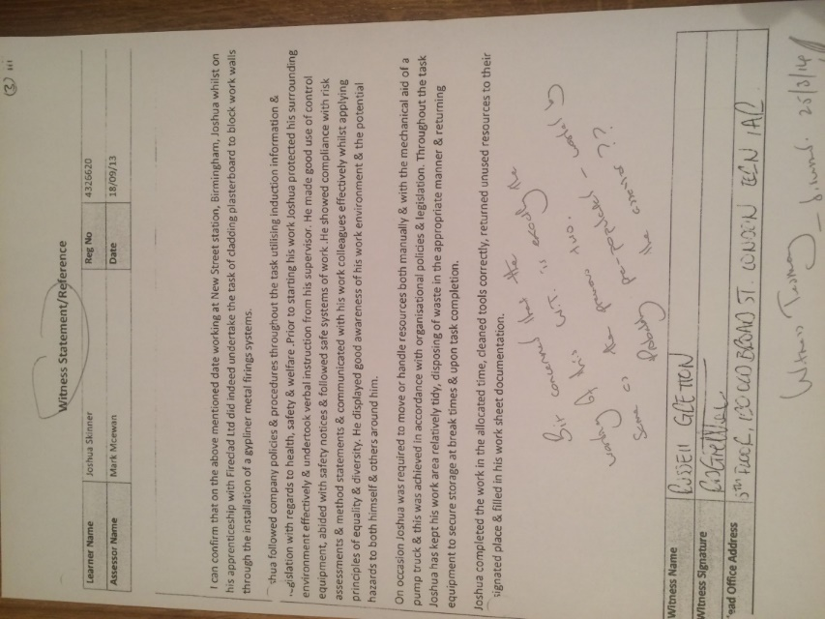
Witness Testimony
next slide >>>>
Notes:
Elicit pro’s & con’s
Ask which of these methods they could see themselves using for Manager qual?

Slide 46
Witness Testimony
Strengths:
- useful for filling gaps in assessment criteria - adds proof of competency over time
Weaknesses:
- might not be genuine - witness biased or not occupationally expertise - statement might not satisfy assessment criteria
Considerations:
- choose witness carefully - ensure contents are relevant to assessment criteria - include name, title & contact details of witness
next slide >>>>
Notes:
Elicit pro’s & con’s
Ask which of these methods they could see themselves using for Manager qual?

Slide 47
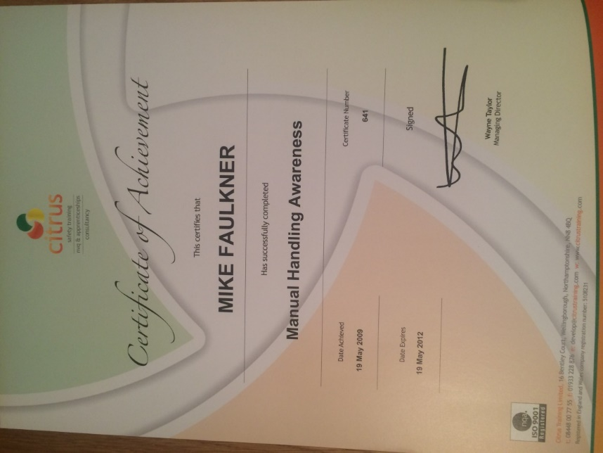
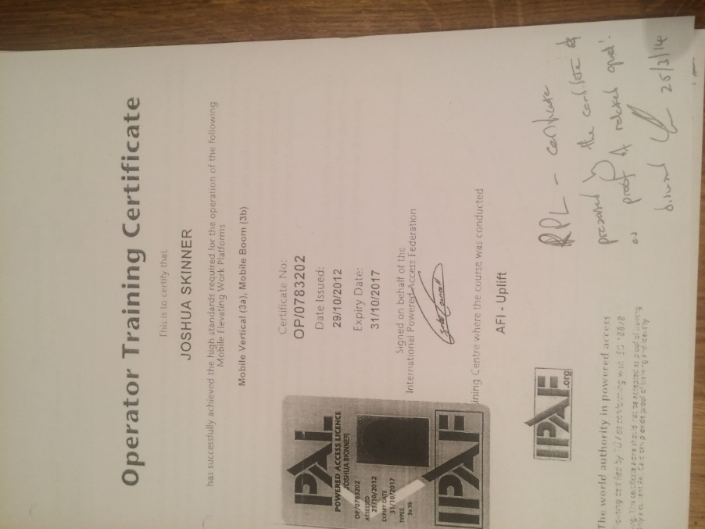
Recognising Prior Learning
RPL / RPA / APL / APA
next slide >>>>

Slide 48
Recognising Prior Learning
Strengths:
- quick & easy to collect - shows competence over time - proves they have achieved a standard
Weaknesses:
- might not be genuine - might not satisfy assessment criteria
Considerations:
- don’t use as sole evidence, just as a back-up - assessor must know about the course - attendance or assessed course?
next slide >>>>
Notes:
Elicit pro’s & con’s
Ask which of these methods they could see themselves using for Manager qual?

Slide 49
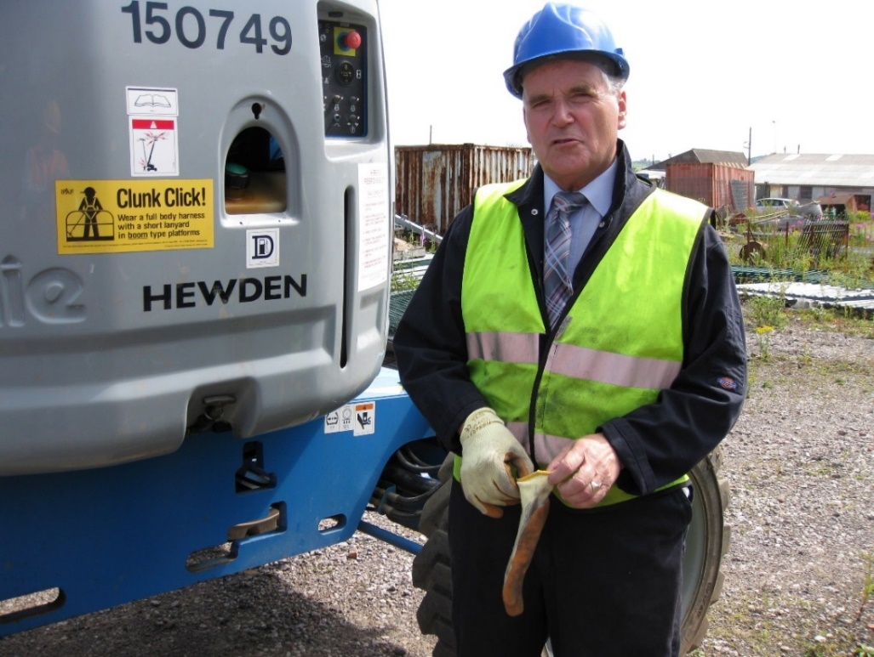
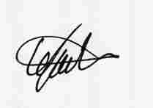
Photographs !!!!
Unit VR 397
Criteria
C 2.4.3.2
C 2.4.3.4
Eric consistently wears his full PPE correctly fastened, clean and tidy.
He also consistently obeys site rules and is fully aware of any surrounding hazards
Assessor
Full Name……………………….….Signed.….…………….…..date…16/02/2019
LUCY FAULKNER
next slide >>>>

Slide 50
Reliability
Most Reliable
Observation
Questions & Answers
Recognising Prior Learning
Examining the Product
Case Study
Initial Assessment
Witness Statement
Photographs
Least Reliable
next slide >>>>
Notes:
We have discussed the Methods of Collecting the Evidence
Which do you think was most reliable?

Slide 51
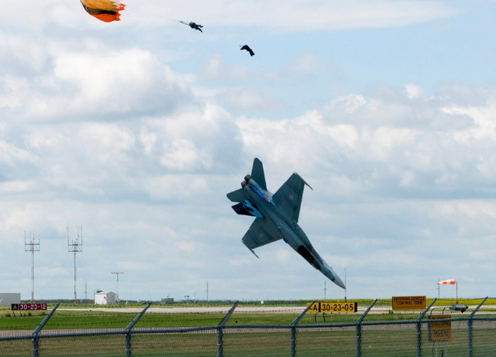
PAPERWORK….
When the whole job turns into a can of worms….
All the paperwork in the world won’t help you
only COMPETENCE will save your neck !!!
>>>> next slide

Slide 52
RQF Assessor Qualification
the Principles of Assessing
 | Pro’s | Con’s
To the Employer
To the Employee
H&S (mandatory?)
Identify weak areas
Efficiency
Quality
Cost
Time
Disruption
improve prospects (inside / outside)
Pay rise!!
Promotion
Job Satisfaction ??!
Nervous (of failure)
Resentment
Extra work
Maximise
Minimise
next slide >>>>
Notes:
Discuss prospects outside (is a disadvantage to employer)
Emphasise that, as an assessor, you should be promoting the pro’s and reducing the con’s.
by your attitude and changing the attitude of others eg the candidates and their supervisors
by your actions by reducing time & disruption & workload and maximising success rate

Slide 53
RQF Assessor Qualification
The Principles of Assessing
This is your role as an Assessor
Why are we assessing these people?
To help the candidate prove they are Competent
Competence
is defined as
“being able to perform WHOLE work roles
to the standards expected in employment
in real working environments”
NCVQ, 1986
next slide >>>>
Notes:
“being able to perform WHOLE work roles
to the standards expected in employment
in real working environments”
NCVQ, 1986
or.....
a practical SKILL plus the
Underpinning KNOWLEDGE & UNDERSTANDING
A

Slide 54
Requirements of Assessment
RQF Assessor Qualification
SAFE & MANAGEABLE
- nobody at risk (physically or emotionally!) - no unnecessary demands (on candidate/assessor/organisation)
SUITABLE TO NEEDS OF CANDIDATE
- achievement free from constraints (see FAIR) - ‘reasonable adjustments’
next slide >>>>

Slide 55
4 Stages of an Assessment
Plan the Assessment
Collect the Evidence
Decide & Record
Feedback
Decide & Record
next slide >>>>

Slide 56
Recording Assessments
RQF Assessor Qualification
Record what happened! - in plain English - keep it relevant to the assessment criteria - include your decision and feedback
eg OBSERVATION REPORT
Annotating Evidence - to keep it ‘authentic’ it must be signed and dated by candidate and assessor - if the evidence is not self explanatory, include an explanatory note!
Mapping Evidence
Progress Reviews
next slide >>>>
Notes:
Explain data protection act implications
and how to deal with sensitive (personal or industrial) evidence

Slide 57
Recording Evidence
Photographs
valid ?
signposting ?
Audio recording ( eg Questions, Discussions )
leading ?
signposting ?
Video recording
signposting ?
Electronic Portfolios
authenticity ?
All “legal” and usually fair, safe, manageable
Easy to record but difficult to signpost
Risk of extraneous evidence which conflicts !
next slide >>>>

Slide 58
4 Stages of an Assessment
Plan the Assessment
Collect the Evidence
Decide & Record
Feedback
Feedback
next slide >>>>

Slide 59
Constructive Feedback
The Two Golden Rules
for
Assessors, Trainers, Supervisors, and Managers
RULE ONE
ALWAYS start off with the positives, what was right, what you liked, what was particularly good before you tell your colleague what could have been done better or what he / she should not have done....
RULE TWO
and if you do have to give negative feedback about what was wrong, ALWAYS tell him / her what should have been done or what needs to be done to put it right, to demonstrate competence, to satisfy requirements.
NB this does not apply to disciplinary situations.
Rob Faulkner
next slide >>>>

Slide 60
FEEDBACK
RQF Assessor Qualification
Feedback should be CLOP
Clear
Limited (three main points?)
Objective (use the standards)
Positive (sandwich)
by the end of your feedback, the candidate must know the next step
next slide >>>>
Notes:
Must include what happens to go forward

Slide 61
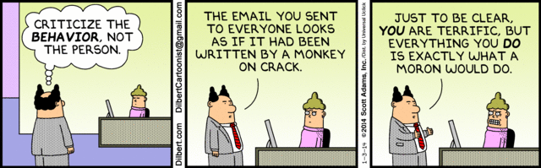
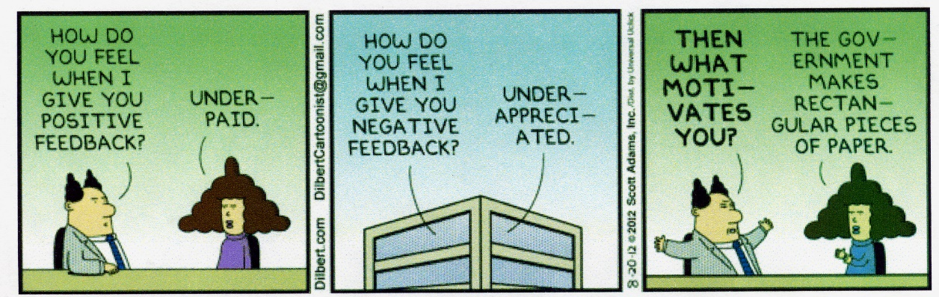
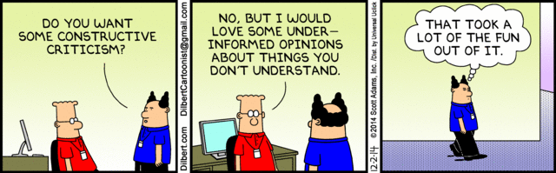
Examples of Constructive Feedback

Slide 62
RQF Assessor Qualification
Induct
Plan
Assess
Decide
Record
Feedback
Review
next slide >>>>
Notes:
That’s all the theory complete
K&U 6,7,8 & 9

Slide 63
The Role of The Assessor
is to help
the Candidates
to prove that they are competent
not to do it for them
but to suggest ways in which
they can demonstrate their competence
and ways in which
they can improve their performance
in order to achieve competence
next slide >>>>
Notes:
Put slide on whilst candidates coming back from tea break

Slide 64
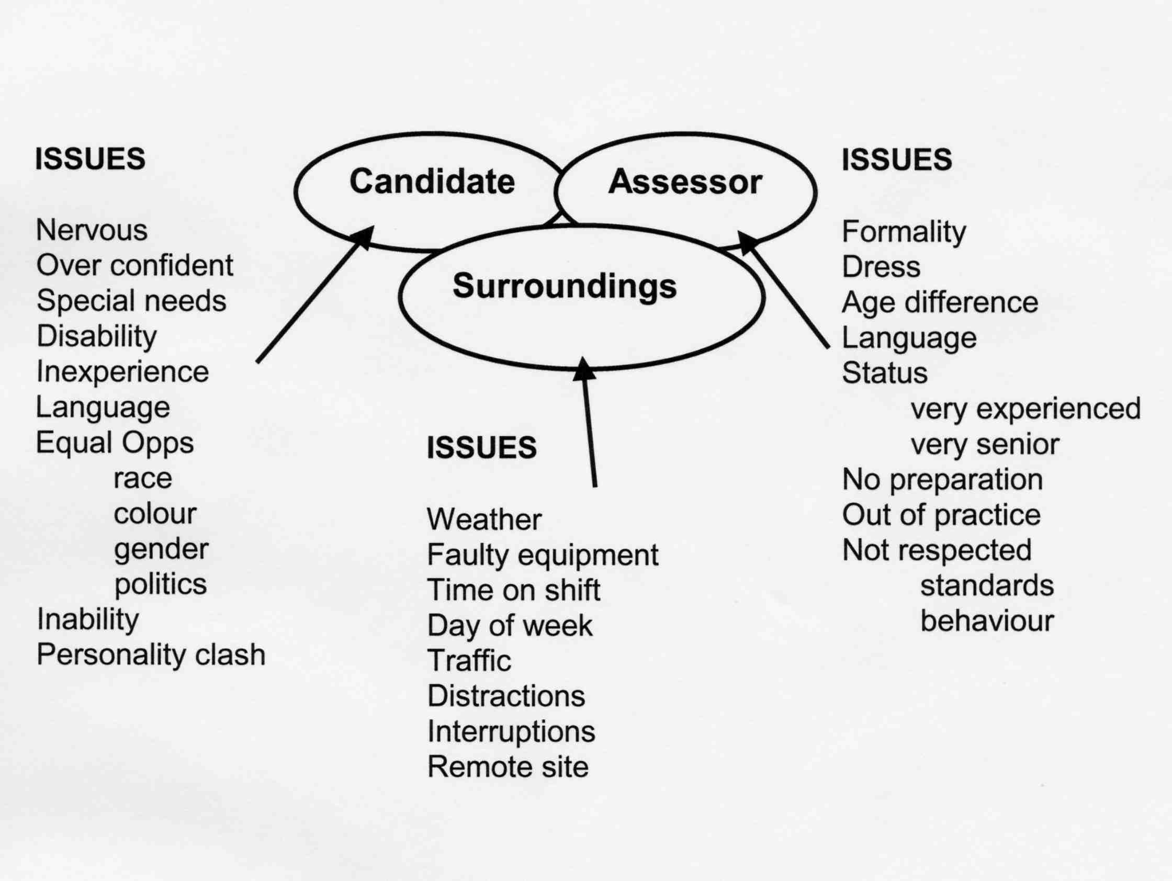
Barriers to Successful Assessment
Notes:
Elicit some issues, then reveal graphic

Slide 65
A Couple of Thoughts….
1. How should Assessors avoid helping, hindering, or distracting
their Candidate ?
[ beware Leading Questions ! ]
Shouldn’t a level 2 Candidate be able to perform the task on his / her own ????
2. When might an Assessor stop an assessment ?
a. If somebody is going to get hurt or something is going to get broken….
b. If the Candidate has “lost the plot” and is getting hot under the collar….
>>>> next slide

Slide 66
and a Question….
How would you give feedback to a Candidate who had just completed an excellent piece of work
~ but had missed one key point ?
Ask about that key point :-
did the Candidate forget
or did he / she not know about it?
You can “pass” the Candidate if you are convinced that he / she knows what should be done and can do it
Otherwise, more training / practice and re-assess
>>>> next slide

Slide 67
What Assessors often get wrong….
1. Telling Candidate how to do the task
2. Interfering during task ~ “training” instead of “assessing”
3. Damning with faint praise ! “not bad” or “quite good”
4. Asking more questions in the middle of feedback
5. Reading through every criterion during feedback
6. Asking Candidates how they thought they had got on….
7..Don’t say “Sorry” !
>>>> next slide

Slide 68
Assessors at Risk !
Risks we take…..
1. Signing off somebody who is NOT competent
beware complacency or “halo factor”
risk of new Assessor passing people who go on to have accidents / upset clients, etc.
2. NOT signing off somebody who is competent
beware being too cautious
risk of upsetting would be Assessor and
subsequent row
>>>> next slide

Slide 69
Quality Assurance
1. Fair ~ is the evidence required equally available to all Candidates ?
2. Reliable ~ are all the candidates being assessed to the same standards ?
3. Valid ~ does the evidence really satisfy the NVQ performance criteria ?
4. Safe and Manageable ~ no unnecessary demands on Candidate or Organisation
5. Suitable to Candidate needs ~ free from constraints outside the Candidate’s job role
6. Sufficient ~ does the evidence cover ALL the assessment criteria and the Evidence Requirements ?
7. Authentic ~ is it the work of the Candidate ?
8. Current ~ can the Candidate still do the task to-day ?
All evidence should also be Consistent, Economic, and Credible
We need to be sure that the evidence really proves that the Candidate is competent
but there is a limit to how much work we can do collecting evidence
next slide >>>>

Slide 70
QUALITY ASSURANCE
Centres conduct internal quality assurance.
The Internal Quality Assurer (IQA) / IV will do this through:
Monitoring assessors
Sampling portfolios
Standardisation (meetings)
Appeals procedure EXAMPLE
External Quality Assurer (EV) audits the internal QA
Centres found lacking will have sanctions imposed
next slide >>>>
Notes:
Your awarding body are trusting you to decide if people are competent and deserve the qualification
(you are the best people to do so because you are occupational experts!)
However, the trust only goes so far because there will always exist an element of ineptitude and corruption
Centres have a portfolio to prove they are competently self QA’ing
EQA (EV) will periodically check that the centre is doing proper QA and will conduct its own QA check.

Slide 71
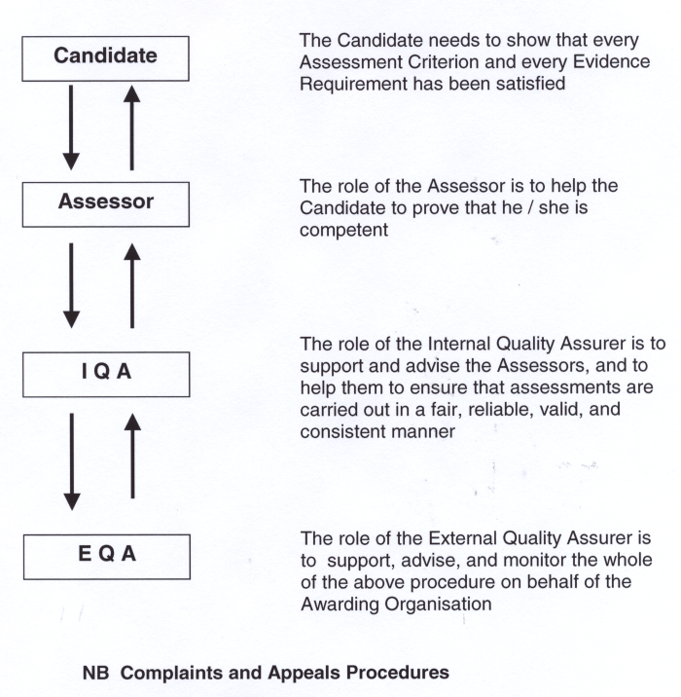
Assessment Organisation Chart
next slide >>>>

Slide 72
Policies and Procedures
Every Approved Centre should have the following in place:-
1. Equal Opportunities Policy
2. IQA / IV Monitoring & Sampling Strategy
3. Health & Safety Policy
4. Appeals and Complaints Procedure
5. Data Protection Policy
next slide >>>>

Slide 73
Regulatory Documents
NVQ Code of Practice (superseded)
Statutory Regulations for External Qualifications (superseded)
Awarding Organisation Regulations for RQF (your own AO)
Regulatory Arrangements for the RQF
next slide >>>>

Slide 74
So what do you do next ???
1. Arrange to carry out another assessment with your first Candidate
2. Carry out TWO more assessments with your second Candidate
copy all the paperwork into your portfolio and make sure that you have assessed at least TWO different Candidates TWICE each in your FOUR assessments
make sure that you have answered the Questions in evidence 7 Knowledge and Understanding ( the Notes in the back of your portfolio will help you answer these )
Scan your evidence to us as you go for continuous help and feedback.
NB avoid huge amounts of scanning !
Usually one or two pages are enough to satisfy the criteria
next slide >>>>

Slide 75
Five reasons why we can’t sign off Assessor’s portfolios….
1. Paperwork NOT signed and dated
2. Witness Statement and Initial Assessment
NOT completed
3. evidence 7 “Professional Discussion”
NOT completed
4. evidence 3. and 4. (TWO further assessments)
do NOT cover a Second Candidate, TWICE
5. Assessment Plans,
Questions asked and Candidate’s Answers,
Feedback after evidence 3. and 4
NOT completed….
NOT paid !
next slide >>>>

Slide 76
Quotable Quotes from Rob
Final Thoughts….
We will do our best to help but it helps if you read the Instructions in your Portfolio ! We have done our best to explain the requirements but we regularly have to ask for extra evidence because people have not followed the instructions
TWO Candidates, TWICE each (not four different ones! )
A COMPLETE Assessment contains:-
Assessment Plan
Observation Report of WHAT was done
Questions answered by your Candidate
Your Feedback on HOW WELL it was done
Explain how you implement the Policies and Procedures
Answer all the questions in ev 7 – ask us for help if you can’t find the answers in the Course Notes
the end
We are supposed to be making sure that Candidates are competent at their JOB, not at building beautiful portfolios
The truth, the whole truth, and NOTHING but the truth. Especially with EVIDENCE ~ a few really good (valid) pieces of evidence are much better than a load of rubbish.
Never use 33 photos where 4 or 5 carefully selected ones will prove as much as we need
Half an hour spent PLANNING all the assessments for the Qualification will save hours of frustration and wasted time not seeing what you need
Candidates should not be spending time doing EXTRA WORK to provide their RQF evidence ~ it ought to come “off the shelf” from what they are already doing at work
Candidates are supposed to identify and bring forward their own evidence (according to the Code of Practice) ~ but please don’t hold your breath ! You need to advise them what evidence to produce

